Slide 1
Lecture 19
Understanding Harmony in the Nature

Slide 2
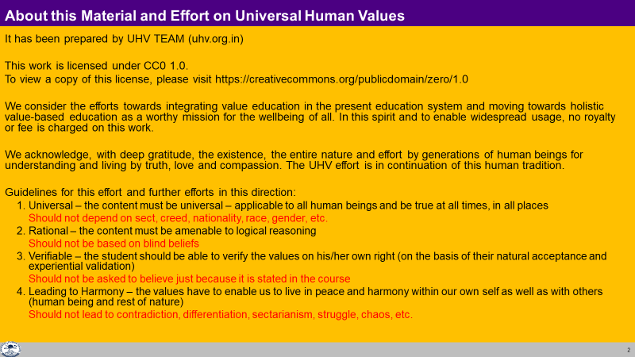

Slide 3
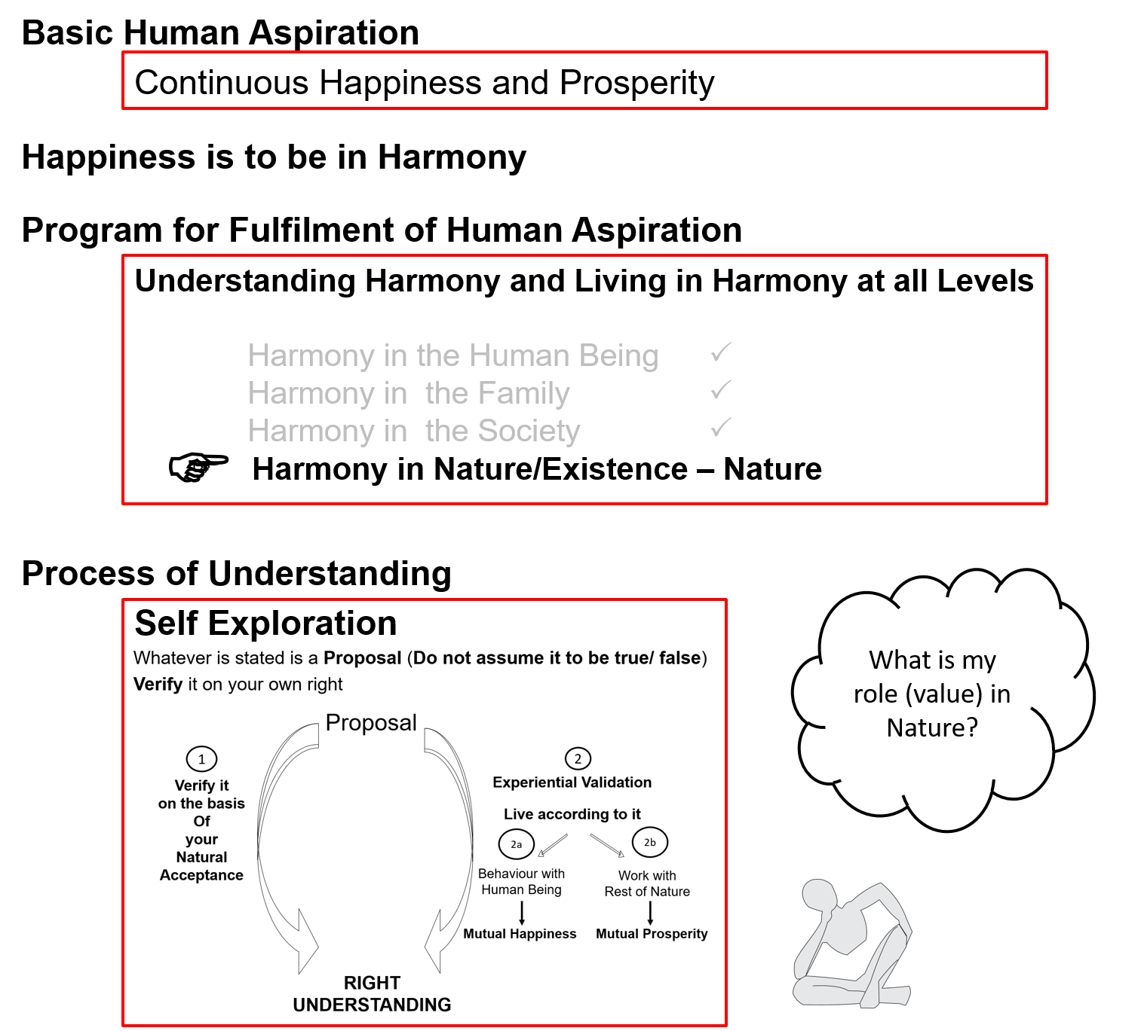

Slide 4
Introduction
So far we have explored our Natural Acceptance
It is for living in Harmony – as an Individual, as a Family, as a Society…
Is there provision in Nature/Existence for living in accordance with our Natural Acceptance?
Is it possible to live in harmony as an Individual, as a Family, as a Society…?
Is co-existence, mutual fulfillment inherent in Nature?
Or
Is the design of nature/existence by way of opposition, struggle, survival of the fittest…?
We will explore the underlying design of Nature/Existence with these questions…

Slide 5


Slide 6
Nature = Collection of Units
Air
Water Trees
Soil
Animal body
Birds Animals Human body
Self(I)
Human Beings
Earth Sun
Moon Metals

Slide 7
Nature = Collection of Units = 4 Orders
All units can be categorised into 4 orders*
* This is one way of categorizing nature (not the only way). It has been classified this way so that it can be helpful in understanding the role of human being vis-à-vis the rest of nature
Bio Order
Plants, Trees
izk.k voLFkk
isM+] ikS/ks
Physical Order
Soil, Metal
inkFkZ voLFkk
feV~Vh] /kkrq
Animal Order
Animals, Birds
tho voLFkk
i”kq+] i{kh
Human Order
Human Being
Kku voLFkk
euq’;

Slide 8
Relationship of Mutual Fulfillment ijLij iwjdrk dk laca/k
Between Physical Order and Bio Order
Interconnected, Interdependent
Mutual Fulfillment
Cyclic
Every unit is enriched
Mutual Fulfillment = Relatedness + Fulfillment
ijLij iwjdrk = ijLijrk + iwjdrk
Bio Order
Plants, Trees
izk.k voLFkk
isM+] ikS/ks
Physical Order
Soil, Metal
inkFkZ voLFkk
feV~Vh] /kkrq

Slide 9
Relationship of Mutual Fulfillment ijLij iwjdrk dk laca/k
Between Physical Order, Bio Order and Animal Order
Interconnected, Interdependent
Mutual Fulfillment
Cyclic
Every unit is enriched
Bio Order
Plants, Trees
izk.k voLFkk
isM+] ikS/ks
Physical Order
Soil, Metal
inkFkZ voLFkk
feV~Vh] /kkrq
Animal Order
Animals, Birds
tho voLFkk
i”kq+] i{kh

Slide 10
Relationship of Mutual Fulfillment ijLij iwjdrk dk laca/k
Physical Order, Bio Order and Animal Order are enriching for Human Order, but Human Order (without right understanding) is not fulfilling for any of the 4 orders
Human beings have
natural acceptance
to be mutually fulfilling
Once human beings understand,
they can be fulfilling for all four orders
Bio Order
Plants, Trees
izk.k voLFkk
isM+] ikS/ks
Physical Order
Soil, Metal
inkFkZ voLFkk
feV~Vh] /kkrq
Animal Order
Animals, Birds
tho voLFkk
i”kq+] i{kh
√
?
√
?
√
?
Human Order
Human Being
Kku voLFkk
euq’;

Slide 11
Nature = Collection of Units = 4 Orders
To understand the other three orders, right understanding of the Human Order is required, otherwise
over-evaluation, under-evaluation or otherwise-evaluation of the other orders keeps taking place.
The presence of Self (I) is
indicated by the presence
of the activity of Assuming
Recognizing, Fulfilling
Bio Order
Plants, Trees
izk.k voLFkk
isM+] ikS/ks
Assuming,
Recognizing, Fulfilling
Recognizing, Fulfilling
Physical Order
Soil, Metal
inkFkZ voLFkk
feV~Vh] /kkrq
Animal Order
Animals, Birds
tho voLFkk
i”kq+] i{kh
Self (I) +
Body
Human Order
Human Being
Kku voLFkk
euq’;
Assuming,
Recognizing, Fulfilling
Possibility for Knowing
Self (I) + Body

Slide 12
Present-day Problems are largely due to Lack of Understanding
Resource Depletion – The resource is used at a rate which is faster than the rate at which it is produced in nature
lalk/ku vHkko & mRiknu esa iz;qDr laalk/ku dh xfr] mlds izÑfr esa iSnk gksus dh xfr ls T;knk gS
Pollution – The product is such that
  It does not return to the cycle in nature or
  It is produced at a rate that is faster than the rate at which it can return to the cycle in nature
iznw’k.k & mRiknu ,slk gS fd
  1- mRikfnr oLrq pØ esa okil ugha vkrh ;k
  2- mRiknu dh xfr izkÑfrd pØz esa okil tkus dh xfr ls T;knk gS

Slide 13

Harmony in Nature iz—fr esa O;oLFkk
Quantity of units in each order
Physical >> Plant >> Animal >> Human
Quantity as per overall enrichment of the whole; and availability of sustaining resources
Dependence of each order is on all
previous orders
Survival of Human Order is
dependent on all the three orders
Role of human being is to ensure
the enrichment, protection and
right utilisation of the rest of nature
Human Order
Animal Order
Plant Order
Physical Order

Slide 14
Harmony in Nature iz—fr esa O;oLFkk
All orders have definite conduct – except human order without right understanding
In human being, the Body has a definite conduct
The Self (I) operating on assuming without knowing is the source of indefiniteness, problem
The solution is to ensure knowing
(understanding harmony)
Human beings inherently have a
natural acceptance to know,
to be in harmony
For this,
human education-sanskar
Is essential
Human Order
Animal Order
Plant Order
Physical Order

Slide 15
Sum Up
Physical order – soil, metals etc.
Bio order – trees, plants etc.
Animal order – animals, birds etc.
Human order – human beings
There is a relationship of mutual fulfilment (harmony) amongst these 4 orders. The first 3 orders are mutually fulfilling for each other. They are fulfilling for human being also. It is naturally acceptable to human beings to be fulfilling for all the orders
The role of human being is to realize this mutual fulfilment – For this, all that human beings need to do is:
  To understand that mutual fulfilment (harmony) is inherent in nature – we do not have to create it
  To live accordingly – then the mutual fulfilment amongst the 4 orders will be realised
      i.e., to ensure the enrichment, protection and right utilisation of the rest of nature
and there is provision in nature for living with mutual fulfilment (harmony)
Nature = Collection of Units
= 4 Orders
Relationship of mutual fulfilment (harmony)

Slide 16
Self Reflection

Slide 17
Self Reflection
What are your assumptions about nature? Is it for human enjoyment or does human being have a role to play for harmony in nature?
In a typical day, how much time do you interact with physical order, bio order, animal order and human order? What is that interaction (taking, giving, appreciating, fulfilling a responsibility…)
How do you and your family contribute to / participate in maintaining the order (harmony) in nature?
Can you see that units of the physical order, bio order and animal order have a definite conduct? Can you see that if the conduct of a human being is in accordance with their natural acceptance, then it will be definite (because the natural acceptance is definite)?

Slide 18
Assignment for Today:
Mention any five programs each that you can make to ensure mutual fulfilment with the Nature:
  As an individual
  As an organization
  As a part of society
Additionally, you may like to watch the 2005 documentary
“An Inconvenient Truth” and reflect on the role of human being in nature

Slide 19
Key Points
Lecture 19: Understanding Harmony in the Nature

Slide 21
Nature = Collection of Units = 4 Orders
All units can be categorised into 4 orders
Bio Order
Plants, Trees
izk.k voLFkk
isM+] ikS/ks
Physical Order
Soil, Metal
inkFkZ voLFkk
feV~Vh] /kkrq
Animal Order
Animals, Birds
tho voLFkk
i”kq+] i{kh
Human Order
Human Being
Kku voLFkk
euq’;

Slide 22
Relationship of Mutual Fulfillment ijLij iwjdrk dk laca/k
Physical Order, Bio Order and Animal Order are enriching for Human Order, but Human Order (without right understanding) is not fulfilling for any of the 4 orders
Human beings have
natural acceptance
to be mutually fulfilling
Once human beings understand,
they can be fulfilling for all four orders
Bio Order
Plants, Trees
izk.k voLFkk
isM+] ikS/ks
Physical Order
Soil, Metal
inkFkZ voLFkk
feV~Vh] /kkrq
Animal Order
Animals, Birds
tho voLFkk
i”kq+] i{kh
√
?
√
?
√
?
Human Order
Human Being
Kku voLFkk
euq’;

Slide 23
Harmony in Nature iz—fr esa O;oLFkk
All orders have definite conduct – except human order without right understanding
In human being, the Body has a definite conduct
The Self (I) operating on assuming without knowing is the source of indefiniteness, problem
The solution is to ensure knowing
(understanding harmony)
Human beings inherently have a
natural acceptance to know,
to be in harmony
For this,
human education-sanskar
Is essential
Human Order
Animal Order
Plant Order
Physical Order

Slide 24
Sum Up
Physical order – soil, metals etc.
Bio order – trees, plants etc.
Animal order – animals, birds etc.
Human order – human beings
There is a relationship of mutual fulfilment (harmony) amongst these 4 orders. The first 3 orders are mutually fulfilling for each other. They are fulfilling for human being also. It is naturally acceptable to human beings to be fulfilling for all the orders
The role of human being is to realize this mutual fulfilment – For this, all that human beings need to do is:
  To understand that mutual fulfilment (harmony) is inherent in nature – we do not have to create it
  To live accordingly – then the mutual fulfilment amongst the 4 orders will be realised
and there is provision in nature for living with mutual fulfilment (harmony)
Nature = Collection of Units
= 4 Orders
Relationship of mutual fulfilment (harmony)

Slide 25
Practice: Which Order does Unit belong to?
Water
Human being
Mosquito
Mango tree
Grass
Moon
Animal Body
Human Body
Recognizing, Fulfilling
Bio Order
izk.k voLFkk
Assuming,
Recognizing, Fulfilling
Recognizing, Fulfilling
Physical Order
inkFkZ voLFkk
Animal Order
tho voLFkk
Self (I) +
Body
Human Order
Kku voLFkk
Assuming,
Recognizing, Fulfilling
Potential for Knowing, Assuming,
Recognizing, Fulfilling
Self (I) + Body

Slide 26
FAQs for Lecture 19
Understanding Harmony in the Nature

Slide 27
Question(s): Classification Response
Why are the units in Nature divided into these 4 categories? What is the purpose of this classification?
For a given unit, how do I make out to which order it belongs to? E.g. fish, insects…
It is said that every living as well as non-living thing has a soul. Please comment

Slide 28
Question(s): Classification Response
How do we know whether a Self is associated with a unit or not?

Slide 29
Nature = Collection of Units = 4 Orders
The presence of Self (I) is
indicated by
1. the presence
of the activity of Assuming
2. Developed part of the Body that can communicate with the Self – Brain
3. Can take signals from HB
To understand the other three orders, right understanding of the Human Order is required,
otherwise over-evaluation, under-evaluation or otherwise-evaluation of the other orders keeps taking place.
Recognizing, Fulfilling
Bio Order
Plants, Trees
izk.k voLFkk
isM+] ikS/ks
Assuming,
Recognizing, Fulfilling
Recognizing, Fulfilling
Physical Order
Soil, Metal
inkFkZ voLFkk
feV~Vh] /kkrq
Animal Order
Animals, Birds
tho voLFkk
i”kq+] i{kh
Self (I) +
Body
Human Order
Human Being
Kku voLFkk
euq’;
Assuming,
Recognizing, Fulfilling
Potential for Knowing, Assuming,
Recognizing, Fulfilling
Self (I) + Body

Slide 30
When there is natural calamity like an earthquake or landslide or huge storm, it creates so much destruction. How can we say that there is harmony in nature?
Similarly extinction of dinosaurs happened for harmony in nature?

Slide 31
Question(s): Mutual Fulfilment Response
There is struggle for survival and survival of the fittest in nature. Why are we saying that there is mutual fulfilment in nature?

Slide 32
Question(s): Mutual Fulfilment Response
Are the problems like global warming a result of human activities only?
Is solely education responsible for the conduct? Are there any other factors?

Slide 33
The JC Bose experiment clearly showed plants could feel pleasure and they could feel pain. So, is there a Self associated with plants?
Dr Imoto did some amazing experiments with water. They showed that there is an impact of feelings on water and water has memory. What is your comment on it?

Slide 34
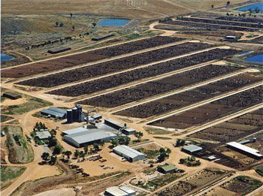
Food for Human Being – Vegetarian, Non Vegetarian, Vegan…
Feeling of Responsibility toward the Body (feeling of self-regulation)
for Nurturing the Body – Naturally Acceptable [Definite, Continuous…]
Food, Choice of Food – Expression of the Feeling [Can have variety, not definite, depends on taste…]
Construction of my Body – Herbivorous, Carnivorous, Omnivorous?
Which order to take food from? Physical, Bio, Animal, Human? Natural Acceptance to take away the Body from any Self?
Sustainable?
20% of all life produced on land every year is harvested for human purposes
14-16 kg grain & 21,000 litres of water → 1 kg meat
The world's cattle alone (not including other livestock) annually consume food grains enough for 8.7 billion people
Land use – 3¼ acres/person on meat diet vs 0.2 acres/person on veg diet
20% Amazon rain forest (the size of California) destroyed since 1970
80% of this land is used for cattle raising
By feeding grain to livestock, we lose 90% of the protein, 96% of the calories, 99% of its carbohydrates, and 100% of the fiber. Animal-based diets are high in saturated fat, excessive protein and cholesterol, leading to heart disease and stroke (nearly 50% of all deaths in the US)
http://www.planetaryrenewal.org/ipr/vegetarian.html

Slide 35
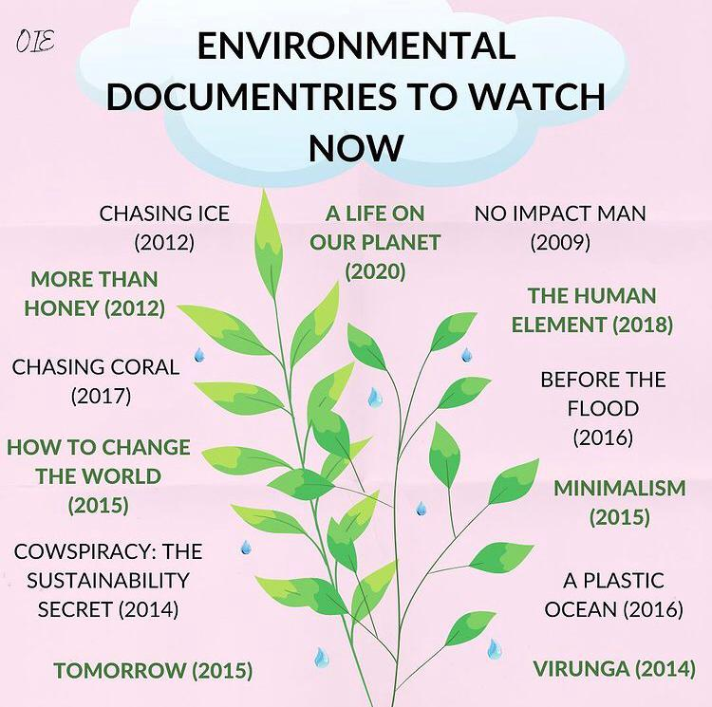

Slide 36
Climate Change 2021 Update
https://www.youtube.com/watch?v=_9d-S7nr204
Temperature Rise of 1.07 degrees in last 60 years
Inevitable additional temperature rise of 1.5 - 2 degrees expected by 2040
Download Full UN Report on Climate Change
(almost 4000 pages, but it has an executive summary)
https://www.ipcc.ch/report/ar6/wg1/#FullReport

